Slide 1
How to Make Your Chamber Business Profile
By Nancy Williamson, CBA Chapin Chamber Board, Scott Hanners State Farm,
& Carolina Web Design and Business Consulting

Slide 2
Step 1 Go to ChapinChamber.com & Log In to using Member Login Button

Slide 3
Step 2 You are now on the “home” page and can create a message (kinda like Facebook – but not really…); then go to Personal Information
I’m signed in as a “user” for Scott Hanners State Farm site

Slide 4
Step 3 – PERSONAL Create your PERSONAL profile information. This is about YOU, not the business (I am creating for Nancy Williamson, not Scott Hanners State Farm)

Slide 5
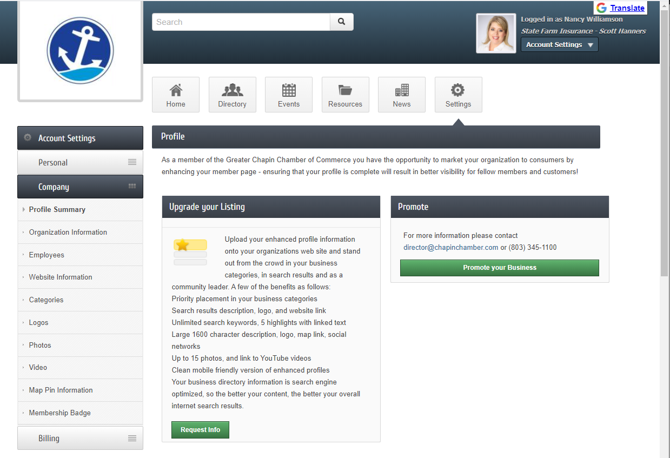
Step 4 – COMPANY Profile Summary - This screen will throw you off, just scroll down to see how complete your company profile is.

Slide 6
Step 4 – COMPANY Profile Summary - Scroll down to see if your information is complete

Slide 7
Step 5 – COMPANY Organization Information – as an authorized user I can’t change
Input fields are gray

Slide 8
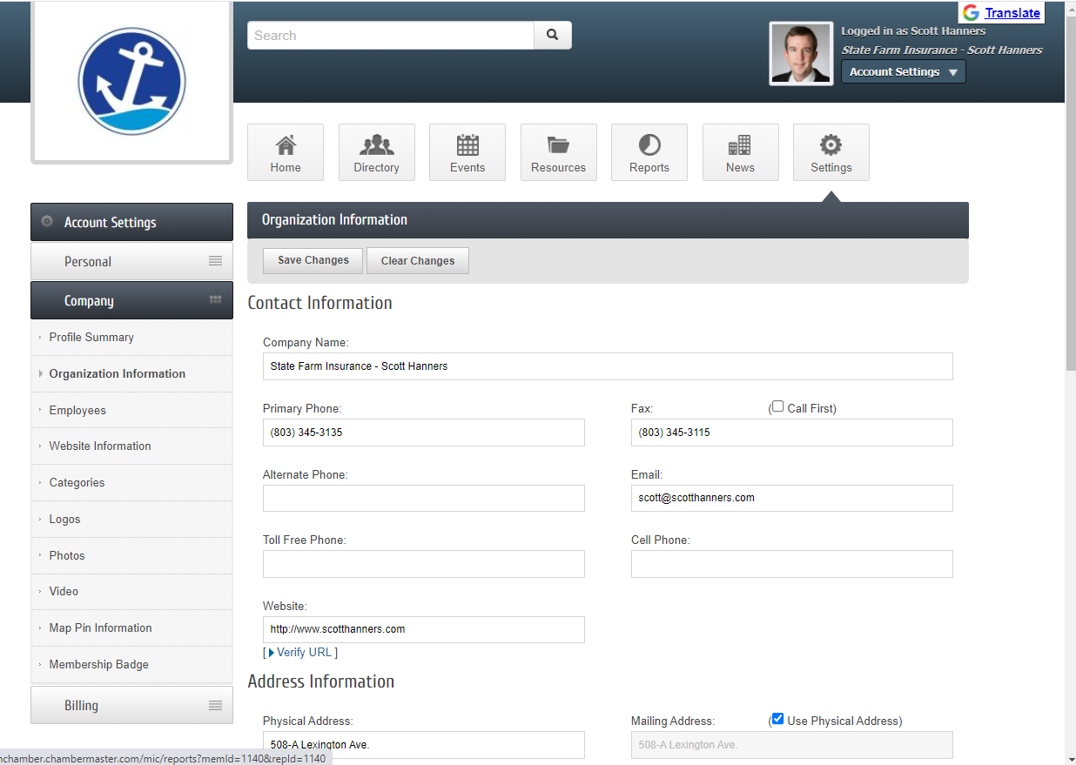
Step 5 – COMPANY Organization Information – as an owner you can update the company info.
I switched to owner Log in.
Be sure to
Scroll down

Slide 9
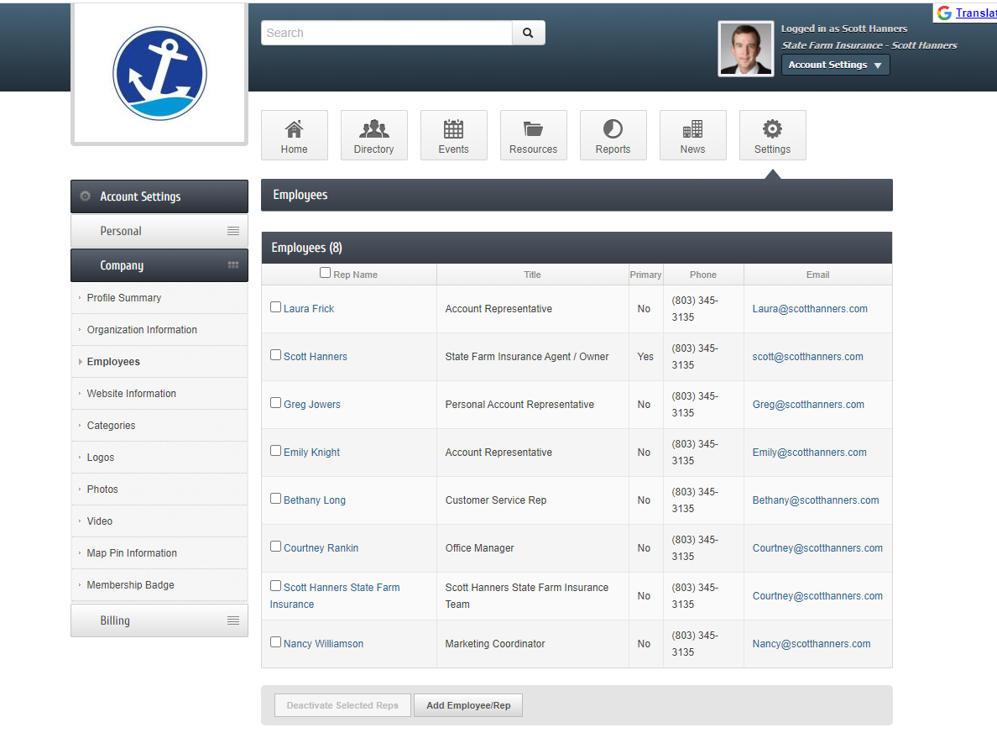
Step 6 – COMPANY Employees – add them all if possible (someone might be searching for them)
Add Employee/Rep

Slide 10
Step 7 – COMPANY Website – this CREATES your company website on the Chamber website
Add Social Links
Copy and past information from your website
Highlights creates bullets of your products/services
Fill out all information, it helps!

Slide 11
Step 8 – COMPANY Logos– SUPER important! This will help you stand out on directory search
Search
Results Icon
REALLY helps!

Slide 12
Search
Results Icon
Makes your business stand out!

Slide 13
Step 9 – COMPANY Photos – add photos of your team, your products, events, etc
Hit Manage Gallery to add photos

Slide 14
Step 10 – COMPANY Video – Link to a video, just copy and paste YouTube link & hit Save Changes

Slide 15
Step 11 – COMPANY Map Pin – pulls address from your organization information page
Check boxes:
Google Maps
And
Show on directory

Slide 16
Step 12 – COMPANY Membership Badge – generates HTML coding for your business website
Generates
HTML Coding to copy and paste
to your website

Slide 17
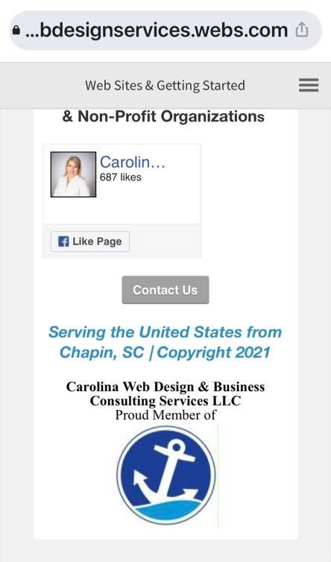
Membership Badge – What it looks like on your website
Being a chamber member adds value to your business, so show off your badge!
Website
Footer
Mobile
Site

Slide 18
Step 13 – BILLING Billing has 4 sections; update your billing info & see transaction history
See all of your transactions paid to the Chapin Chamber since you joined.

Slide 19
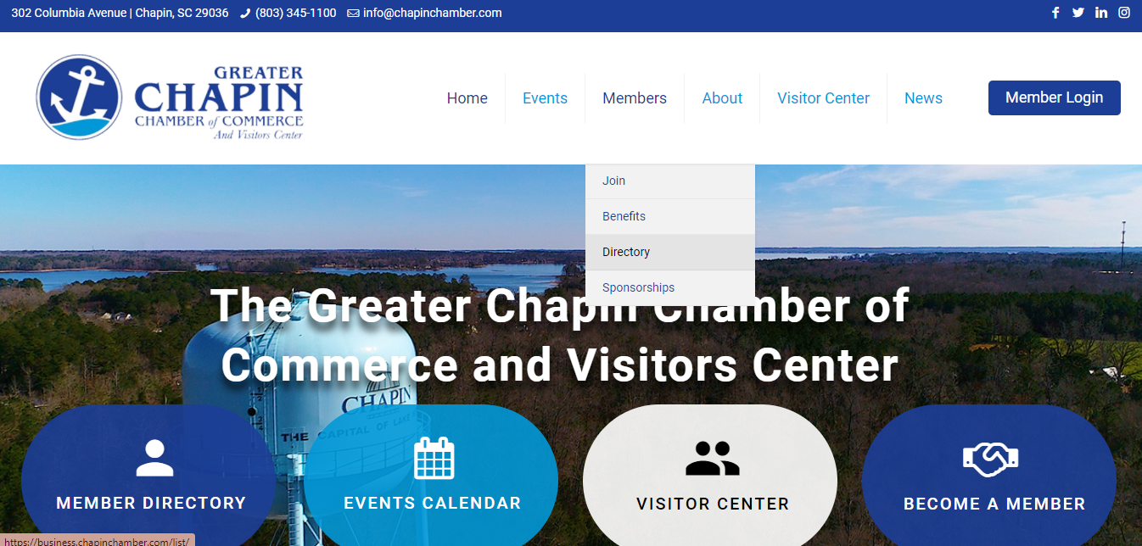
DONE! Review your listing Go to chamber website in a new tab: ChapinChamber.com Click on Members, then down to Directory

Slide 20
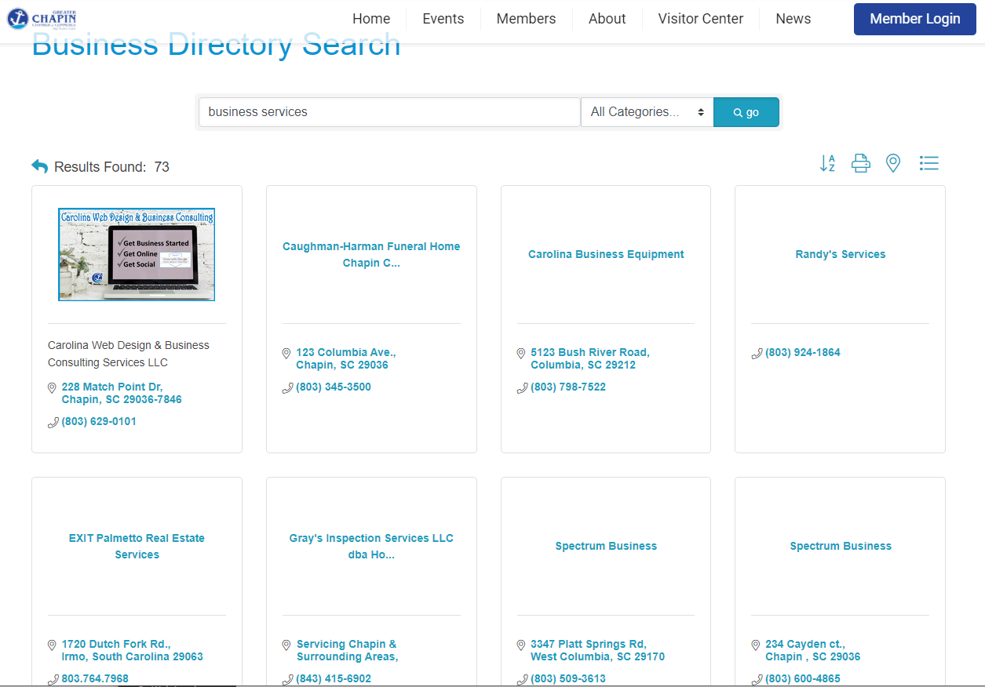
Step 14 – Review your listing Type in your industry See if you stand out! Your “Search Icon” should appear in your listing.
STAND OUT
Online with a Complete Directory!

Slide 21
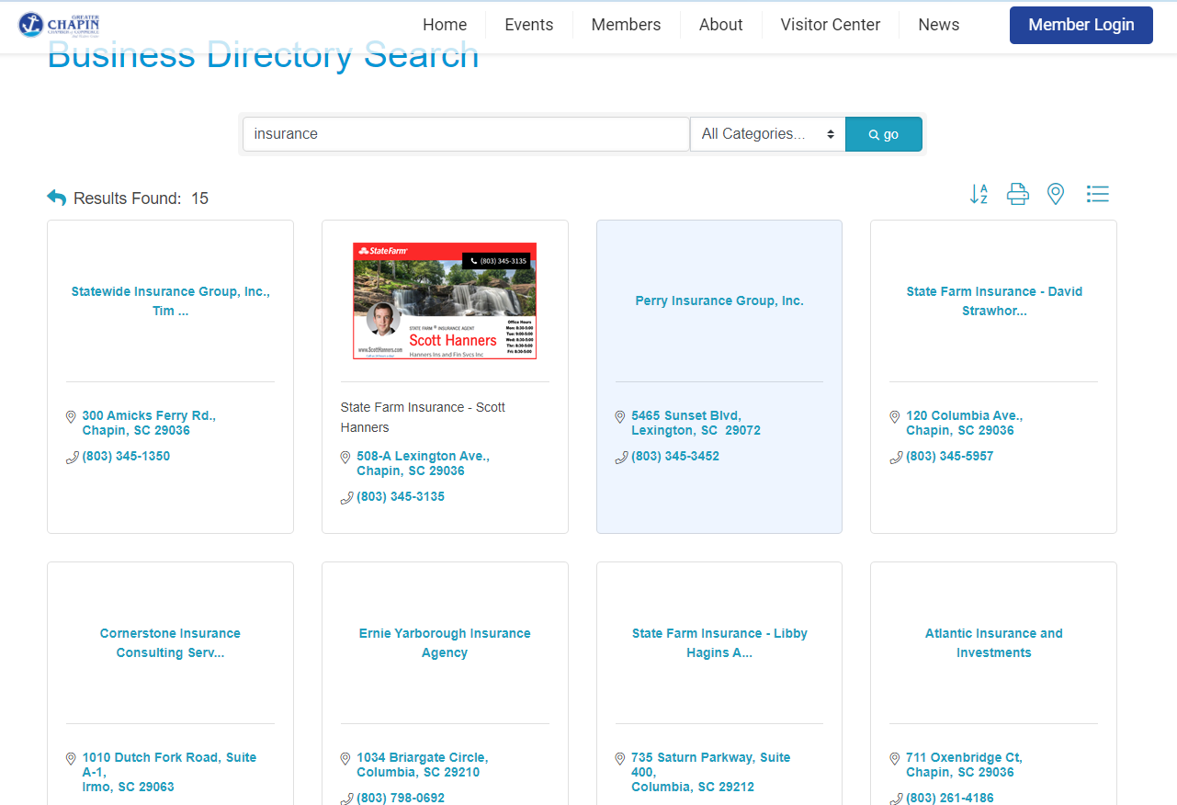
Step 15 – Click on listing Type your name in Directory Search and see what shows up.
Then review your Chamber
“Website” by clicking on your box

Slide 22
Update your Company Profile to go from this…

Slide 23
To this!

Slide 24
Questions?

Slide 25
Thank you for joining us! How to Make Your Chamber Business Profile

